Slide 1


Are Pokemon Getting More Powerful From Gen1 to Gen 7?
Visualization: Plots + Shiny App
BIS 15L- Group 16: Tianyu Lin
Zhuoya Wang
Notes:
Originating in 1996, Pokémon is more than just a game, it is a universe that contains multiple elements such as animation, movies, and card games. Over the past few decades, it has successfully captured the hearts of countless players and fans. How has the world evolved from the first to the seventh generation? Are they getting more powerful with each generation? We will present some results by plots and shiny app to find the answer.

Slide 2

Introduction & Data Exploration
Relative tidy data – type 2
801 Rows & 41 Columns
Variables: names, percentage_male, type1,
type2, height_m,weight_kg,capture_rate,
against_?(18), hp, attract,defense,generation, if_legendary…
Reference:https://www.kaggle.com/datasets/rounakbanik/pokemon
https://serebii.net/
Notes:
The dataset contains 801 unique Pokemon and 41 distinctive variables. And it is relatively neat. Our data cleaning part only replaces the blanks in the variable named type2 with none, because nearly half of the Pokémon do not have 2 types. It mainly contains Pokémon's height, weight, catch rate, 18 effectiveness, and primary type. Both categorical and numerical variables help us make an in-depth comparison of the characteristics of each generation of Pokémon.

Slide 3
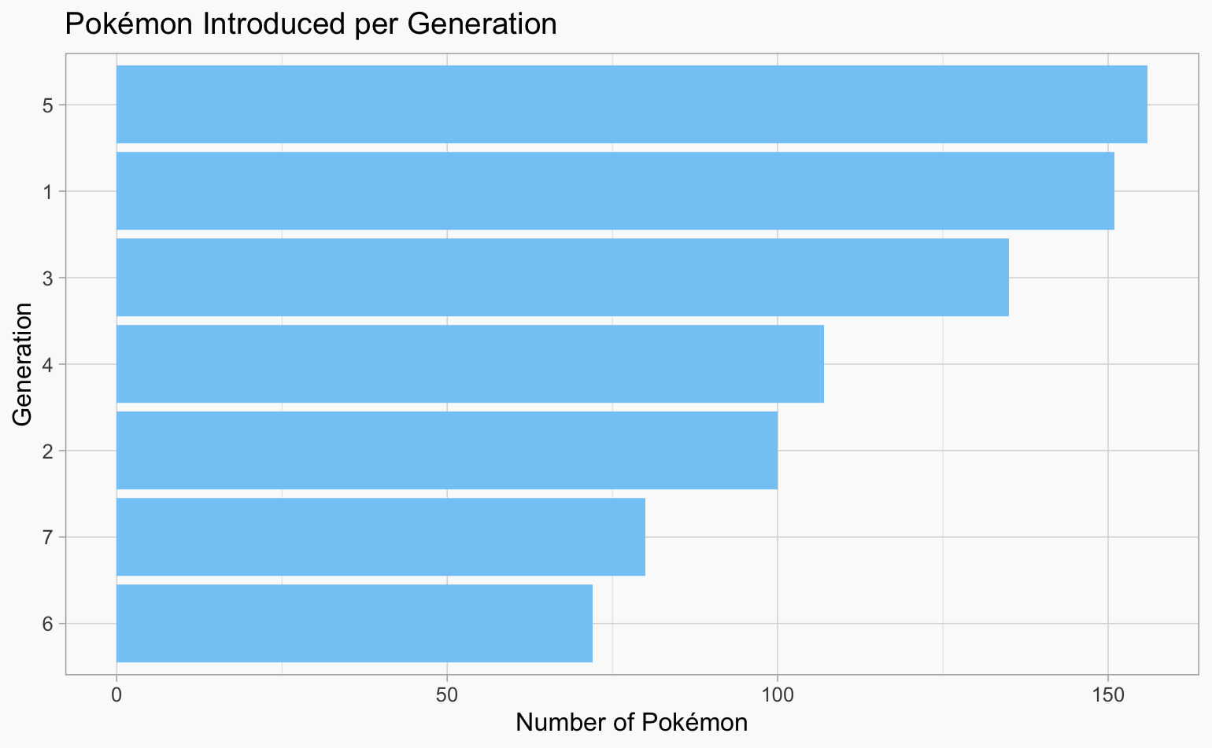

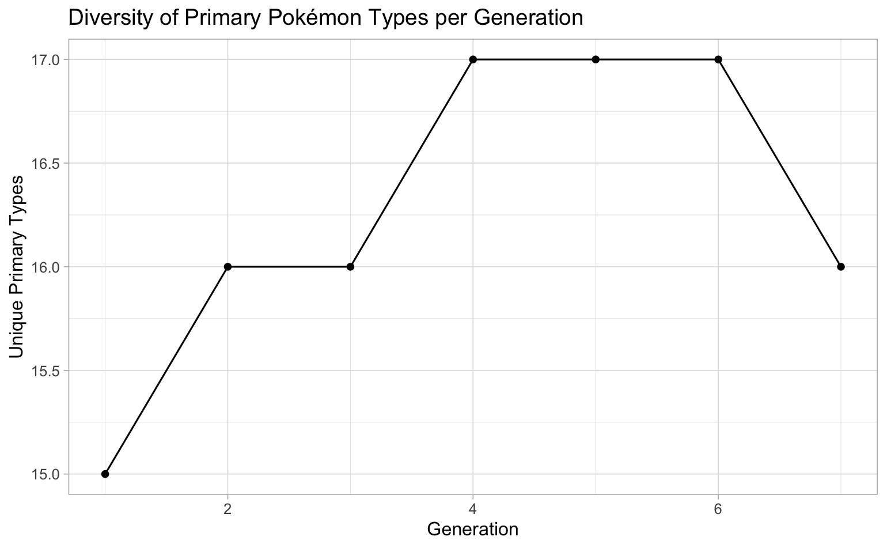
Diversity：
Gen 5 has the most Pokémon
Gen 4 & 5 & 6 have the most unique primary type Pokemon
Notes:
Regarding the Diversity of each generation. In the barplot, x-axis is the number of Pokemon introduced, and y -axis is the generations. The 5th generation introduced the most Pokémon. And the line plot alongside with generation on x-axis and the number of unique primary type Pokemon on the y-axis tells us the peak of diversity of Primary type in Generations 4 , 5, and 6.

Slide 4
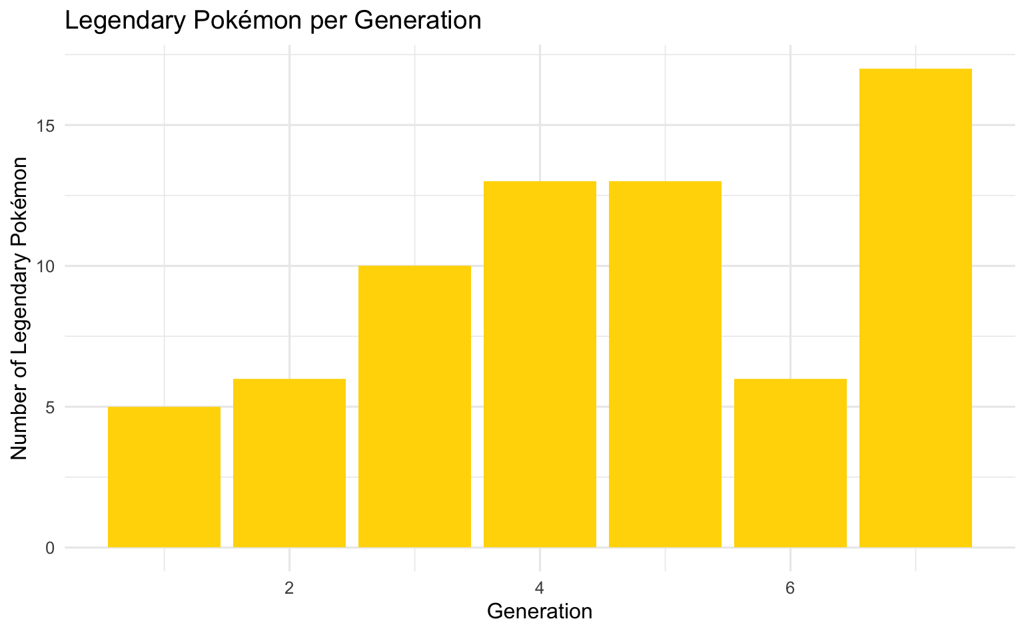
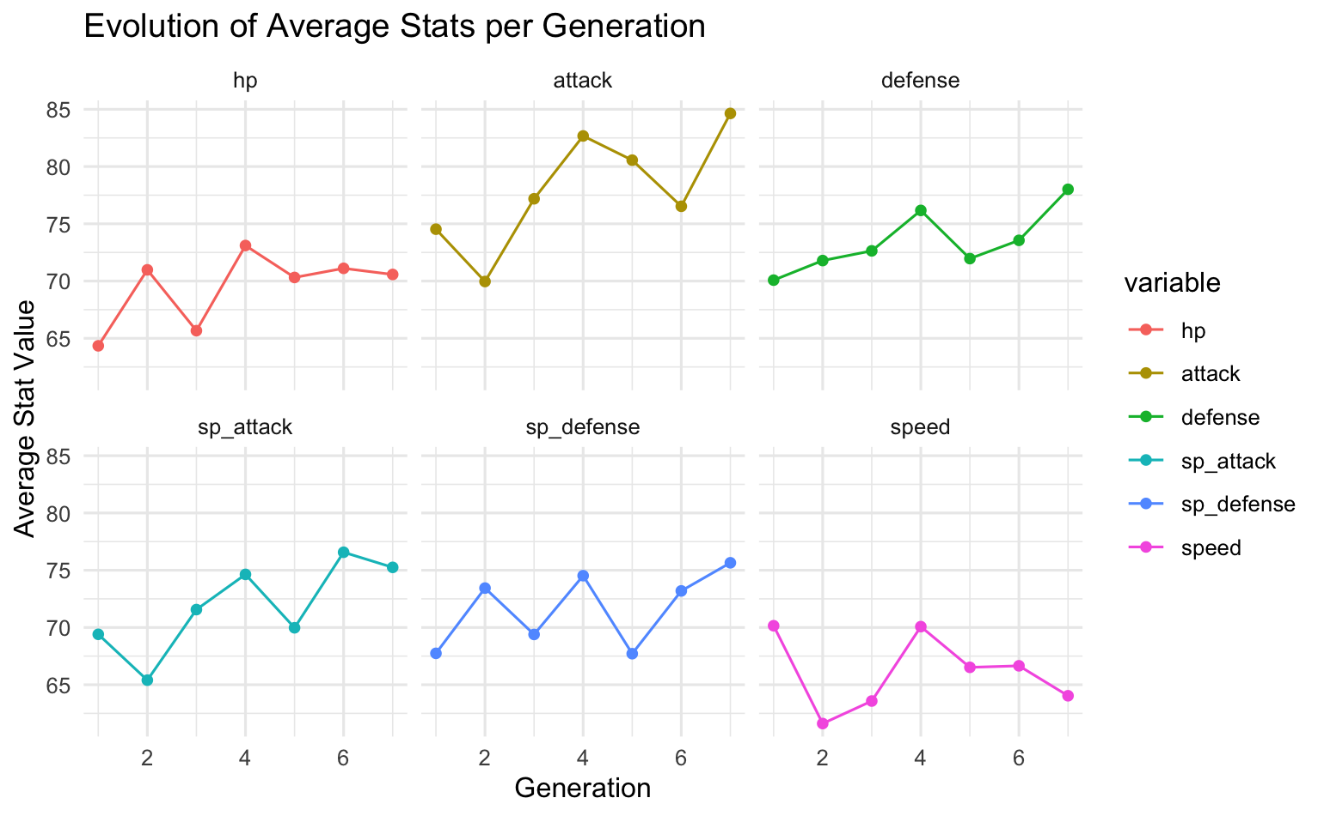

Statistic Trends:
hp: Base HP(hit point) a numerical attribute representing the health.
Gen 4 has the highest hp and speed on average. Gen 7 has the highest defense, sp defense, and the most legendary Pokemon.
Guess ???
—If number of legendary pokemon affect avg stats?
Notes:
We also discovered some interesting statistical trends. For example, the fourth generation of Pokémon has the highest average health and speed, while the seventh generation has improved special defense and introduced the most legendary Pokémon. The evolution of these attributes across generations is evidence that the Pokémon world is constantly changing, with each evolution showing us different powers and strategies

Slide 5
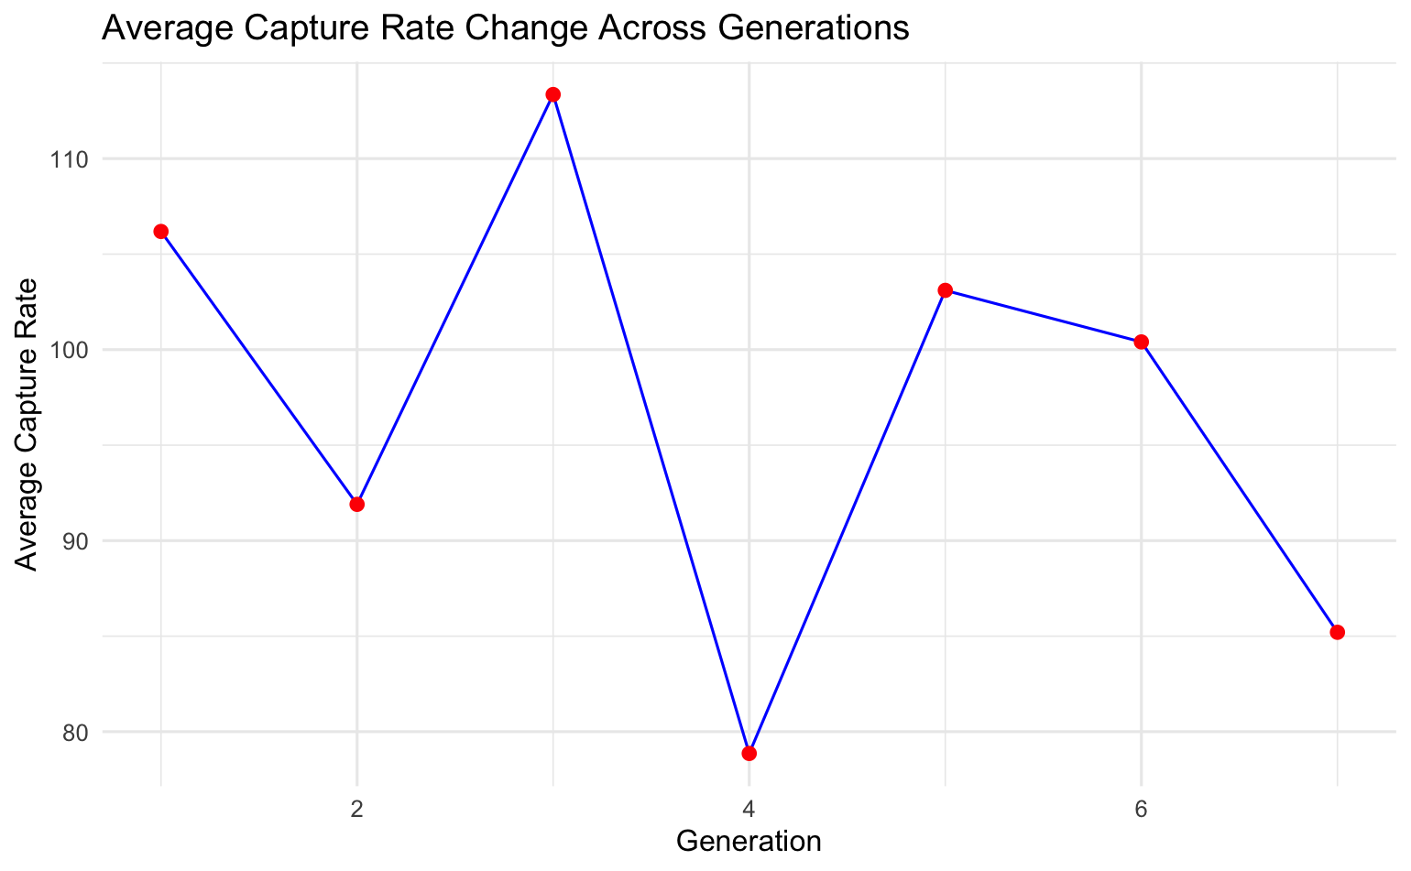

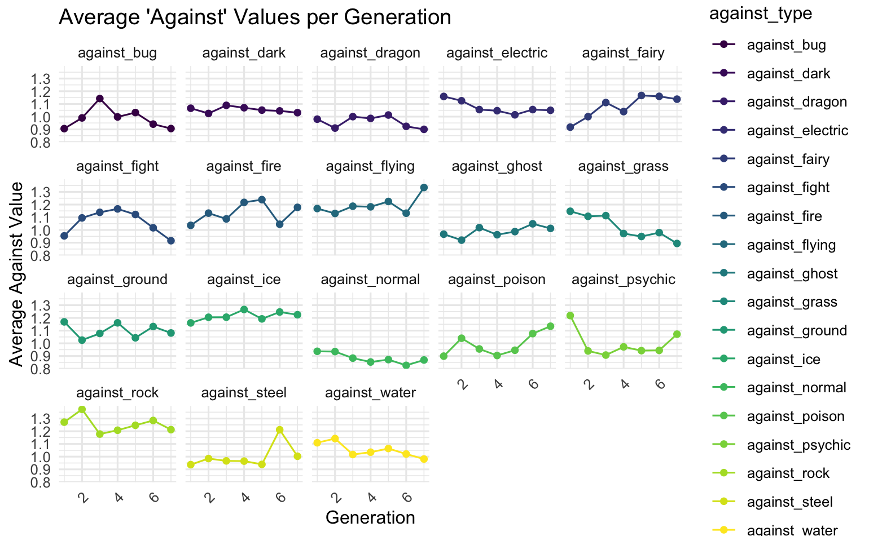
Capture and Against_type
Answer to previous question: No

Slide 6
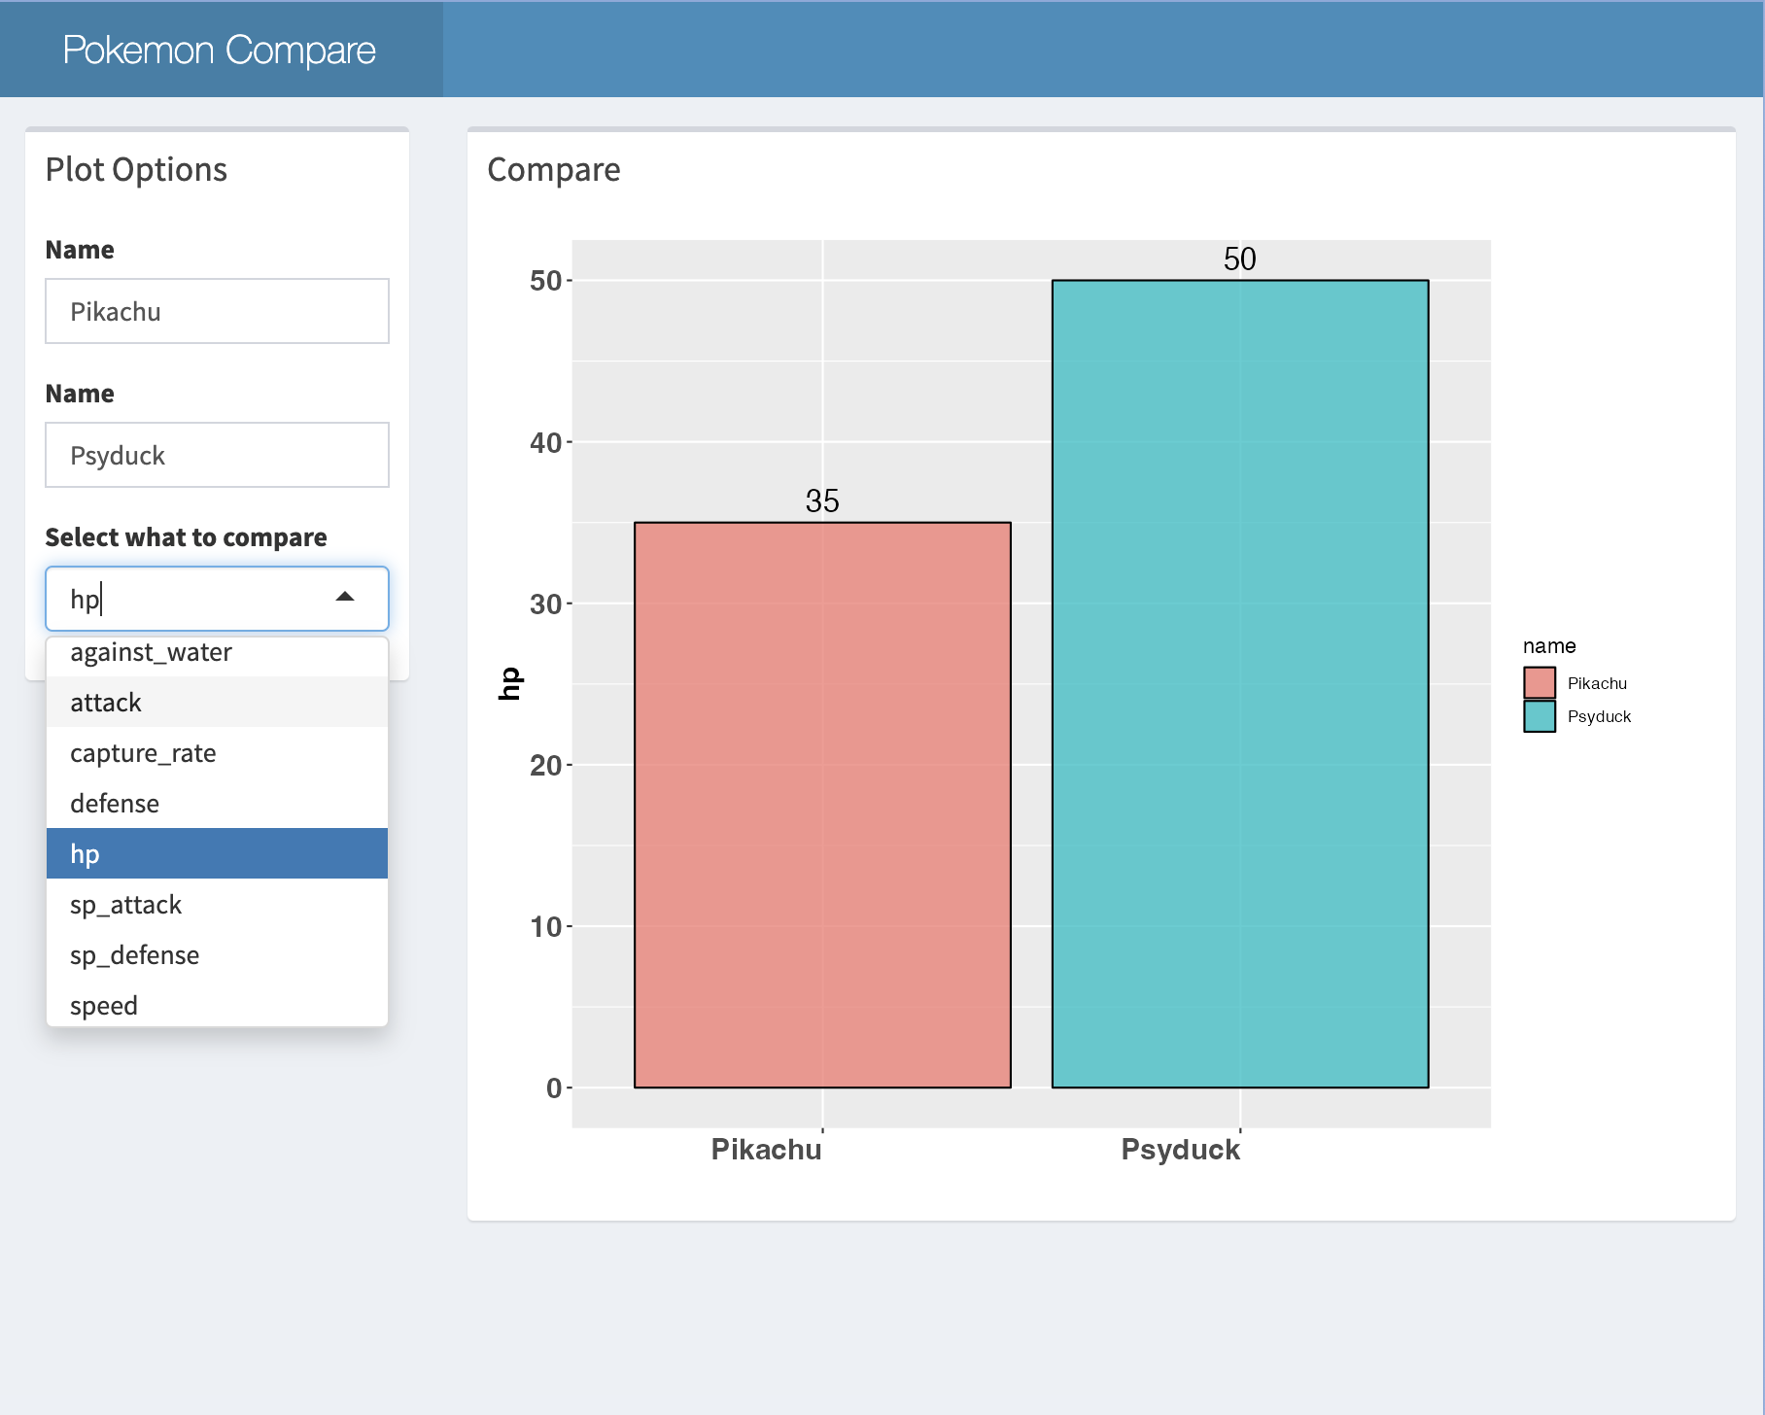

Shiny Apps—
Comparison between Pokémon

Slide 7

Thank you for your listening!

